Slide 1



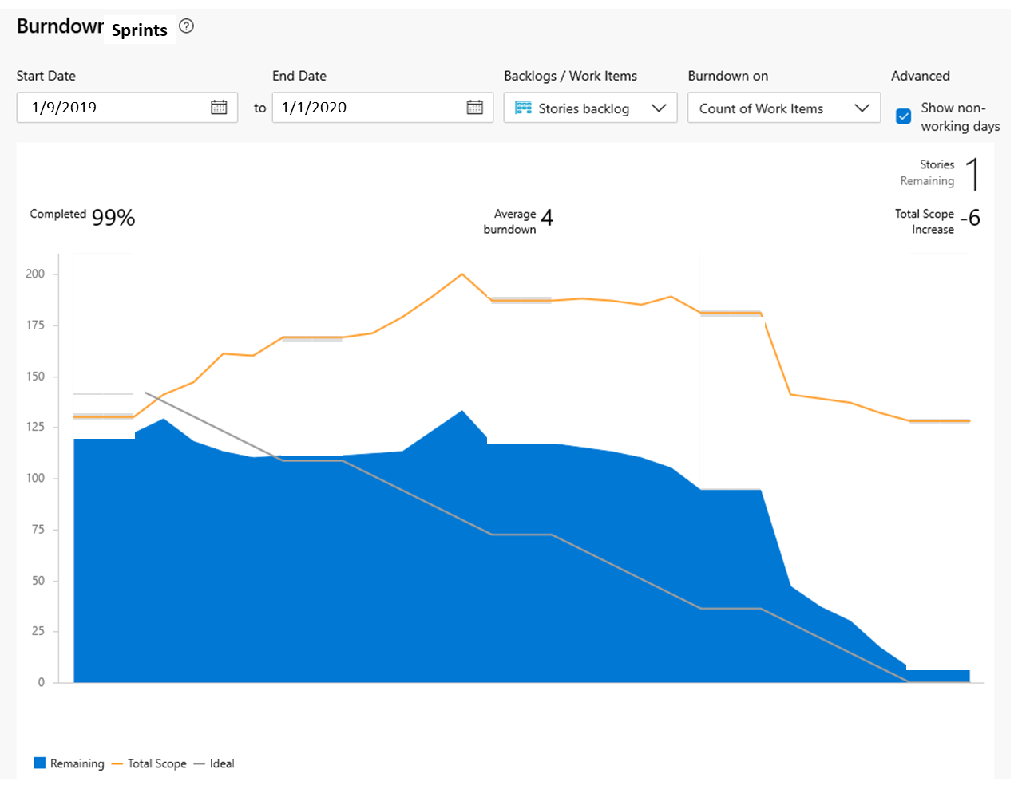
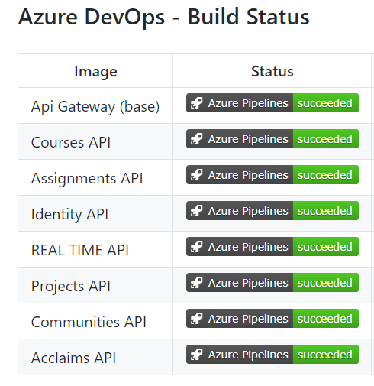

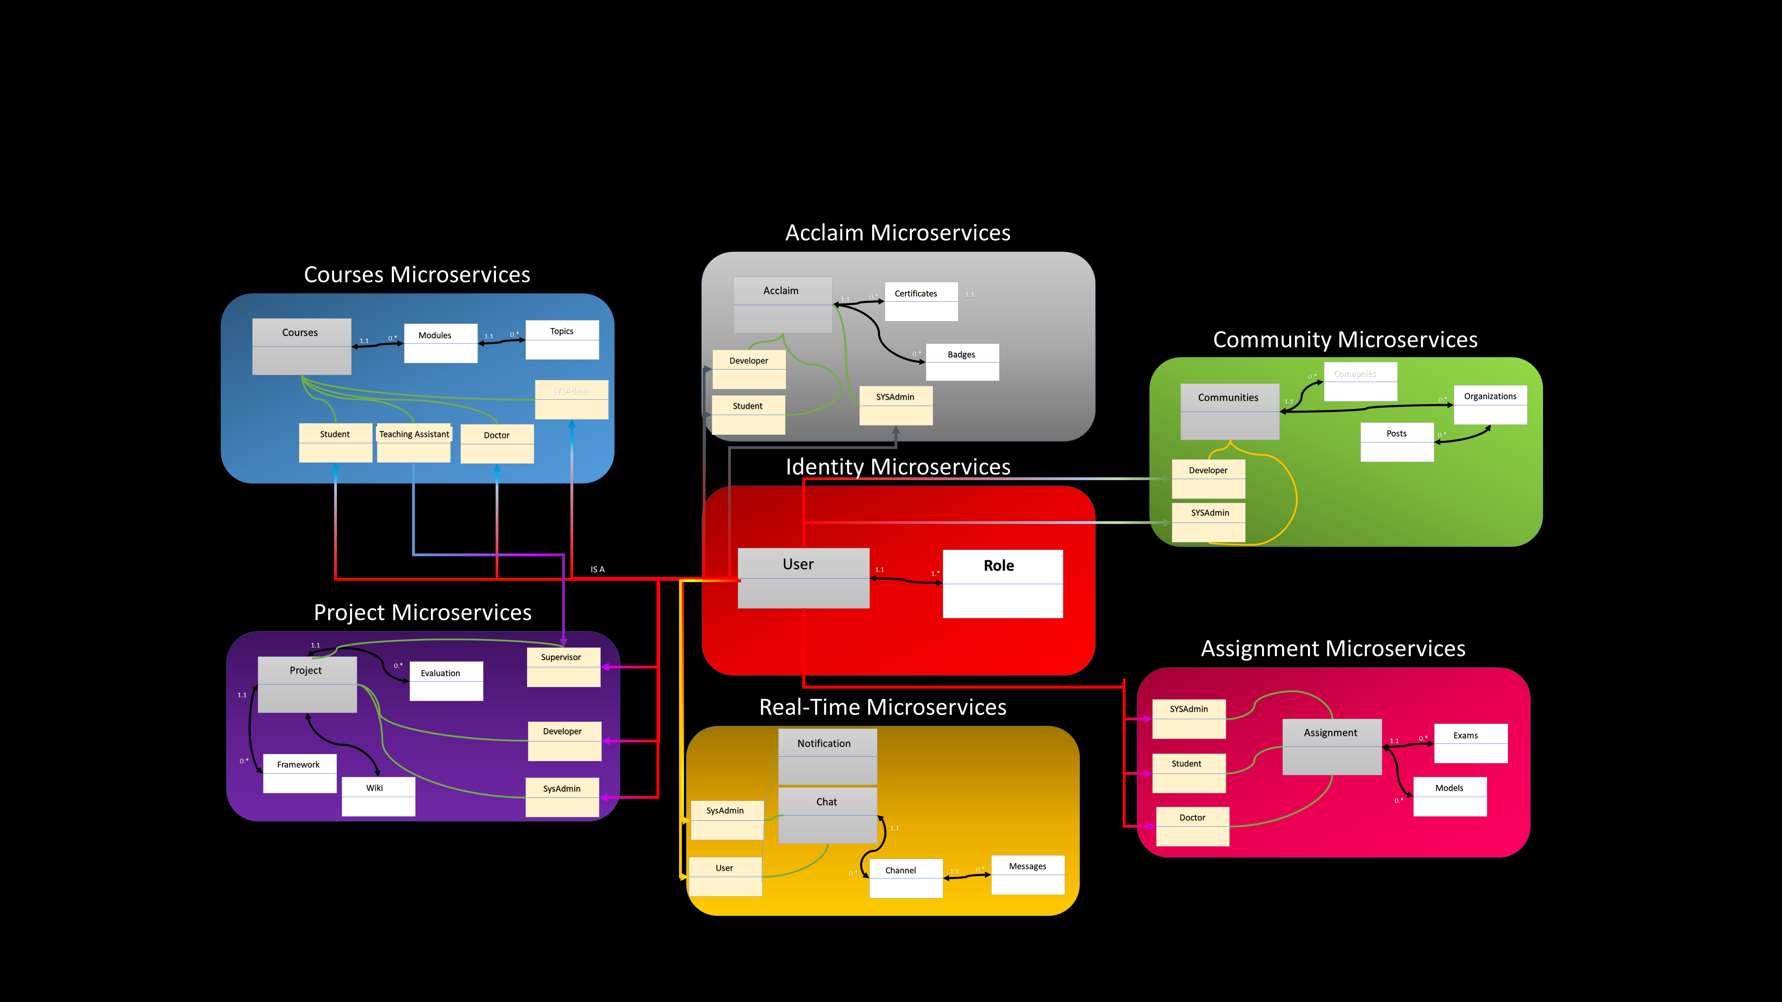
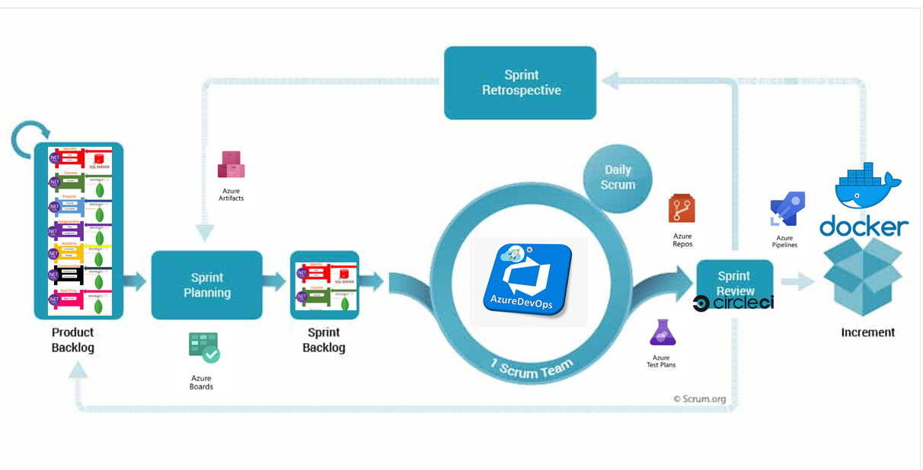
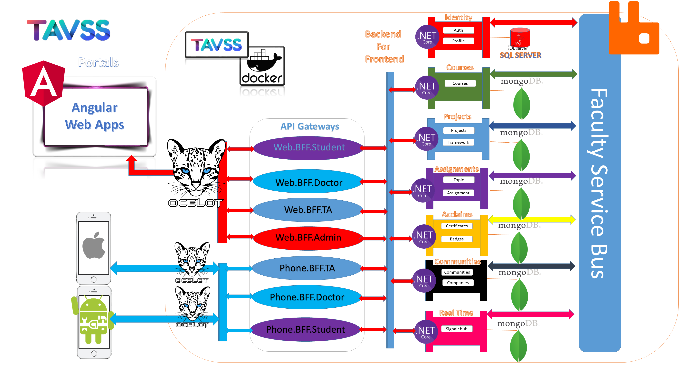
Abstract
e
RESULTS
IOS Developer
UI & UX designer
Ahmed Abu El-Regal
Heba Esmail
The Project is an application and architecture of how to use the Microservices Architecture to build an Interactive Learning services for students of practical faculties to optimize the performance, applying different design patterns that can integrate any type of services or platforms or programming languages, this architecture is composed of internal and external services as components or small projects that interact with each other. the business vision of the project takes the student into a lifecycle of 4 levels (Skills Building – Entertainment - Interaction – Career development) using Internal services like project, course, schedule, tasks, games and assignment management; and external services like communities, teams, companies, training centers, market places and integration by the business using new methods of interaction like evaluation, chatting, blogging and cv development using standards,
the conceptual model show these interactions of Microservices illustrated in the following figure
Android Developer
UI & UX designer
Islam Khater
Merna Osama
Android Developer
Frontend developer
Mohammad Anter
Noura Abd El-Naser
Backend Developer
Solution Architect
Frontend Developer
System Analyst
Mohammad Ashraf
Ahmed Khalil
Ahmed Abu Zahra
Rana Hesham
Microservice Interactive
Learning System
Supervisor : DR Samir Abd El-Razik
Conceptual Model
Background
• The Traditional Monolithic systems have not the ability to sustain the learning systems and they don’t scalable enough to integrate new methodologies of learning from the external environments. Accepting the Microservice architecture and the Agile processes to these environments make a new life for solving all the problems.
• Imagine that the faculty need to adapt a new service, with different development architecture and different programming languages, the traditional systems can’t handle it, but the Microservice have this ability to merge and conquer all other systems; make the process of development very easy by divide the development teams to SCRUMS illustrating the process in the following figure.
System Architecture
Objectives
Project Team
Microservices Know How ?
Faculty
Improving Teaching Techniques
Optimizing System Performance
Integrate External Services
Students
Connecting to work places
Challenging & interactive Learning

